Slide 1
UNIT II DIVIDE AND CONQUER
Session – 15

Slide 2
Syllabus
Introduction, Binary Search - Merge sort and its algorithm analysis - Quick sort and its algorithm analysis - Strassen's Matrix multiplication - Finding Maximum and minimum - Algorithm for finding closest pair - Convex Hull Problem

Slide 3
Introduction
Divide / Break
Conquer / Solve
Merge / Combine

Slide 4
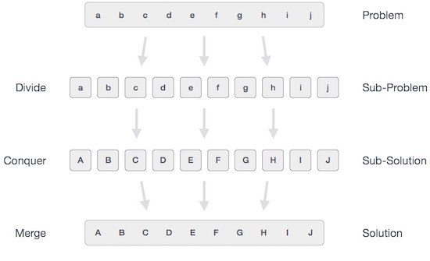

Slide 5
CONVEX HULL PROBLEM
A polygon is convex if any line segment joining two points on the boundary stays within the polygon.
The convex hull of a set of points in the plane is the smallest convex polygon for which each point is either on the boundary or in the interior of the polygon.
A vertex is a corner of a polygon. For example, the highest, lowest, leftmost and rightmost points are all vertices of the convex hull.

Slide 6
Different algorithms
Graham Scan,
Jarvis March
Divide & Conquer
We present the algorithms under the assumption that no 3 points are collinear (on a straight line)

Slide 7
Graham Scan
The idea is to identify one vertex of the convex hull and sort the other points as viewed from that vertex.
Then the points are scanned in order.
Let x0 be the leftmost point (which is guaranteed to be in the convex hull) and number the remaining points by angle from x0 going counter clockwise:
x1; x2; : : : ; xn-1.
Let xn = x0, the chosen point. Assume that no two points have the same angle from x0.

Slide 8
Graham Scan Algorithm
The algorithm is simple to state with a single stack:
1. Sort points by angle from x0
2. Push x0 and x1. Set i=2
3. While i <=n do:
If xi makes left turn w.r.t. top 2 items on stack, then { push xi; i++ }
else { pop and discard }

Slide 9
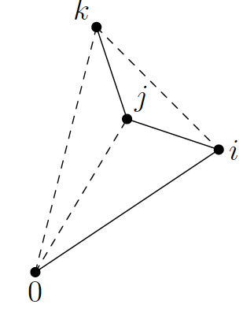
To prove that the algorithm works, it success to argue that:
A discarded point is not in the convex hull.
If x_{j} is discarded, then for some i < j < k the points xi --> xj --> xk form a right turn. So, x_{j} is inside the triangle x0, xi, xk and hence is not on the convex hull.
What remains is convex. This is
immediate as every turn is a left turn.

Slide 10
Running time of Grahams scan
Each time the while loop is executed, a point is either stacked or discarded. Since a point is looked at only once, the loop is executed at most 2n times.
There is a constant-time subroutine for checking, given three points in order, whether the angle is a left or a right turn.
This gives an O(n) time algorithm, apart from the initial sort which takes time O(n log n).

Slide 11
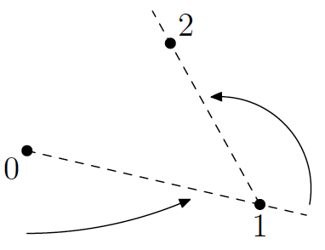
Jarvis March
This is also called the wrapping algorithm.
This algorithm finds the points on the convex hull in the order in which they appear.
It is quick if there are only a few points on the convex hull, but slow if there are many.
Let x0 be the leftmost point. Let x1 be the first point counter clockwise when viewed fromx0. Then x2 is the first point counter clockwise when viewed from x1, and so on.

Slide 12
Jarvis March Algorithm
i = 0
while not done do
xi+1 = first point counter clockwise from xi
Finding xi+1 takes linear time.
The while loop is executed at most n times. More specifically, the while loop is executed h times where h is the number of vertices on the convex hull. So Jarvis March takes time O(nh).
The best case is h = 3.
The worst case is h = n, when the points are, for example, arranged on the circumference of a circle.

Slide 13
Divide and Conquer method
1. Divide the n points into two halves.
2. Find convex hull of each subset.
3. Combine the two hulls into overall convex hull.
Combining two hulls
It helps to work with convex hulls that do not overlap. To ensure this, all the points are presorted from left to right. So we have a left and right half and hence a left and right convex hull.
Define a bridge as any line segment joining a vertex on the left and a vertex on the right that does not cross the side of either polygon. What we need are the upper and lower bridges.

Slide 14
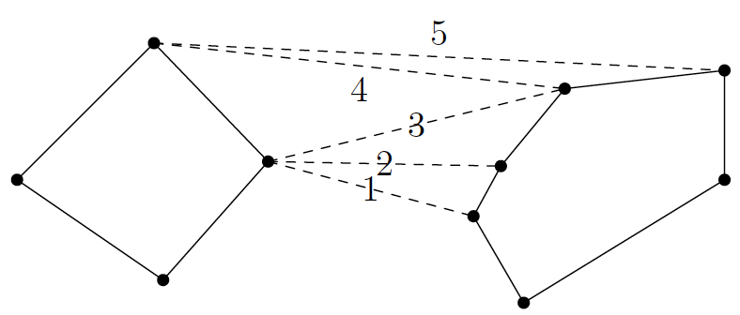
The following produces the upper bridge.
Start with any bridge. For example, a bridge is guaranteed if you join the rightmost vertex on the left to the leftmost vertex on the right.
Keeping the left end of the bridge fixed, see if the right end can be raised. That is, look at the next vertex on the right polygon going clockwise, and see whether that would be a (better) bridge. Otherwise, see if the left end can be raised while the right end remains fixed.
If made no progress in (2) (cannot raise either side), then stop else repeat (2).

Slide 15
Running time
The key is to perform step (2) in constant time. For this it is sufficient that each vertex has a pointer to the next vertex going clockwise and going counter clockwise.
Hence the choice of data structure: we store each hull using a doubly linked circular linked list.
It follows that the total work done in a merge is proportional to the number of vertices. This means that the overall algorithm takes time O(nlog n).

Slide 16
Worksheet No. 15

